Slide 1


MonetDB Column-Oriented DBMS
Lylian Blaud
04 June 2014

Slide 2
Flashback
Do you remember ?
4Vs (Volume, Variety, Velocity, Veracity)
Row-Oriented
Online Transaction Processing (OLTP)
Online Analytical Processing (OLAP)
Cloud Computing
Open-Source

Slide 3

Summary
Big Data
e-Learning Platform
Row-Oriented DBMS
Column-Oriented DBMS
Optimized Performance
Performance Comparisons between MySQL and MonetDB
Future Work

Slide 4

Big Data

Slide 5





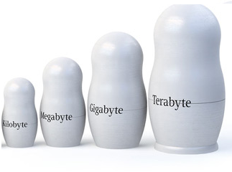
e-Learning
Variety: Different type of data
Volume: Data increase all time
Velocity: The data need to be treated now? Or later?

Slide 6

e-Learning
Modular Object-Oriented Dynamic Learning Environment (Moodle)
Open-Source platform
Increasing interest

Slide 7

Cloud Computing
What is Cloud Computing?

Slide 8




e-Learning
Moodle + Cloud = Cloodle

Slide 9
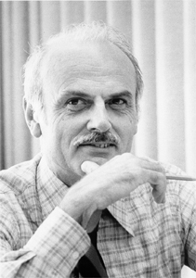

Row-Oriented DBMS
History
The relational model, first proposed in 1970 by Dr. Edgar Frank Codd.
Received the Turing Award in 1981.

Slide 10
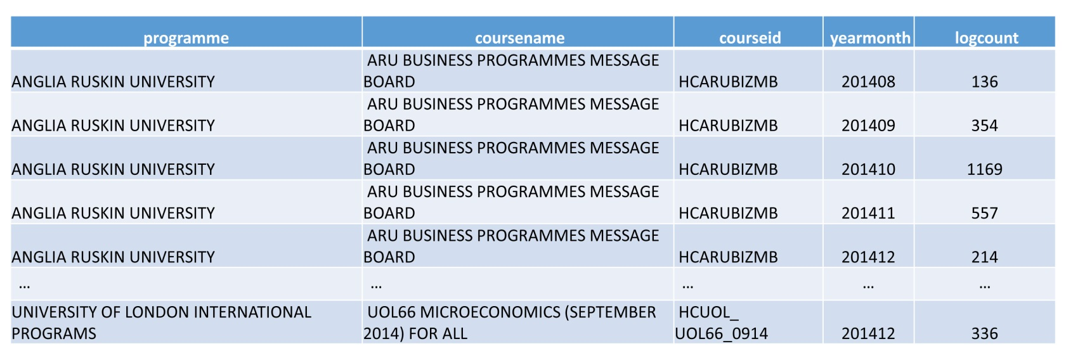
Row-Oriented DBMS
Example of database
A two-dimensional array containing a set of n-tuples (rows)

Slide 11
Row-Oriented DBMS
What is it?
DBMS → Database Management System
Store data in row fashion
High performance writes in Online Transaction Processing (OLTP) applications

Slide 12



Row-Oriented DBMS
id | Name | Post_category | Content | Date
1 | Lylian Blaud | Status | “Hello !” | 05/19/2015 10:00
2 | Lylian Blaud | Status | “Row-Oriented?” | 05/19/2015 10:01

Slide 13

Row-Oriented DBMS
MySQL
Open-Source RDBMS (Relational Database Management System)
Cross Platforms (Windows, Linux, …)
Row-Oriented DBMS

Slide 14




Row-Oriented DBMS
Cross Platforms?

Slide 15

Column-Oriented DBMS
History
Column stores or transposed files have been implemented from the early days of DBMS development.
Statistics Canada implemented the RAPID system in 1976 and used it for processing and retrieval of the Canadian Census of Population and Housing as well as several other statistical applications.

Slide 16
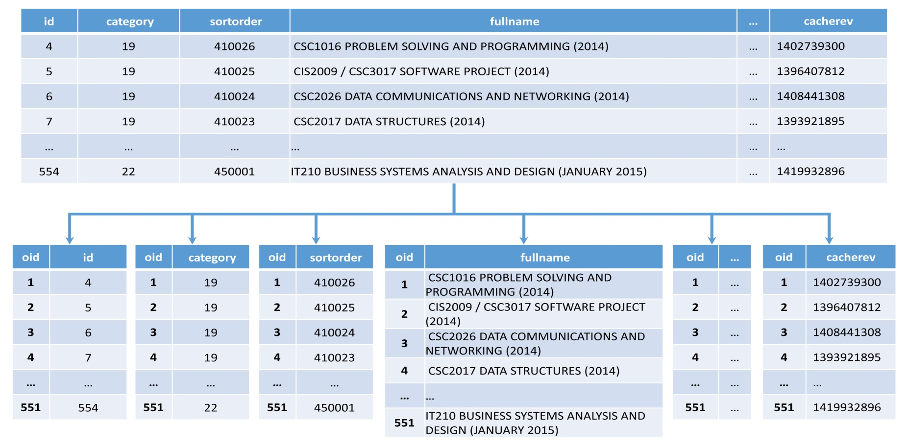
Column-Oriented DBMS
What is it?
Store each column in a table with a reference ID (oid) that can be used for the joins

Slide 17
Column-Oriented DBMS
What is it?
id | Name | Post_category | Content | Date
1 | Lylian Blaud | Status | “Hello !” | 05/19/2015 10:00
2 | Lylian Blaud | Status | “Row-Oriented?” | 05/19/2015 10:01
oid | id
101 | 1
102 | 2
oid | Name
101 | Lylian Blaud
102 | Lylian Blaud
oid | Date
101 | 05/19/2015 10:00
102 | 05/19/2015 10:01
…
High performance in Online Analytical Processing (OLAP)

Slide 18

Column-Oriented DBMS
MonetDB
Open-Source DBMS
Cross Platforms (Windows, Linux, …)
Column-Oriented DBMS

Slide 19
Column or Row?
So Row- or Column-Oriented DBMS?
id | Name | Post_category | Content | Date
1 | Lylian Blaud | Status | “Hello !” | 05/19/2015 10:00
2 | Lylian Blaud | Status | “Row-Oriented?” | 05/19/2015 10:01
oid | id
101 | 1
102 | 2
Row-Oriented
oid | Name
101 | Lylian Blaud
102 | Lylian Blaud
oid | Post_category
101 | Status
102 | Status
Column-Oriented
oid | Content
101 | “Hello”
102 | “Row-Oriented?”
oid | Date
101 | 05/19/2015 10:00
102 | 05/19/2015 10:01

Slide 20
Optimization Performance

Slide 21
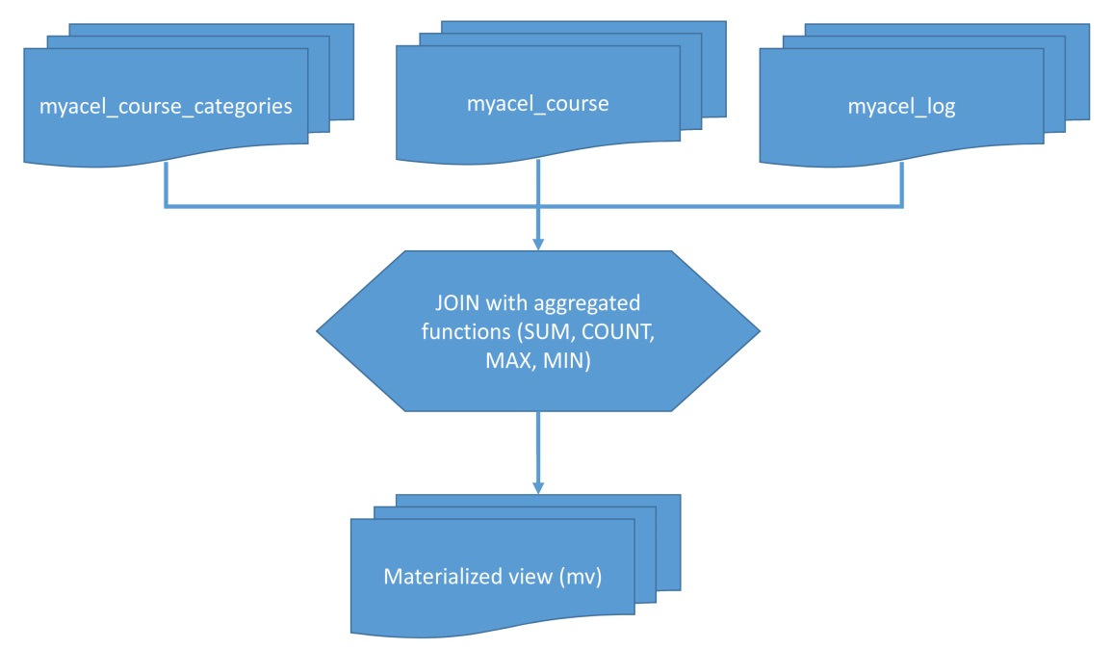
Optimized Performance
Materialized view
Pre-computed data using aggregation functions (such as SUM, COUNT, MIN, MAX)
Massive improvement in query processing time

Slide 22
Optimized Performance
Before Materialized View
Col1 | Col2 | Col3 | Col4 | Col5 | Col6
1
2
3
4
…
5,000,000

Slide 23
Optimized Performance
After Materialized View
Group1 | Group2 | Group3 | Group4 | Group5 | Group6
Summary1
Summary2
Summary3
Summary4
…
Summary30,000

Slide 24
Optimized Performance
Query Rewriting
Using the materialized view for rewrite the same query but simpler
The query rewrite does not recompute, therefore it’s runs faster than the first query
If the query is long, difficult and need to compute, the result return time will be long also

Slide 25
Optimized Performance
Query Rewriting
Example:
If the first query Q is “give me the total connection per day” and if we already have evaluated (and stored) the total connection per day per course, the new query Q’ can be rewritten as:
“give me the sum of totals per day per course”
Q and Q’ return the same result but the rewritten query is easier to evaluate because it reuse already stored results

Slide 26
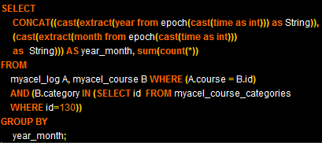
Optimized Performance
Query Rewriting
Example:

Slide 27
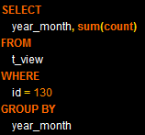
Optimized Performance
Query Rewriting
Example:

Slide 28
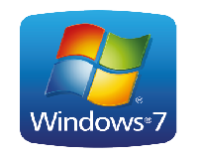


Environment
Performance comparison between MonetDB and MySQL
For do the test we dispose of one computer with these characteristics:
5 Million rows

Slide 29
Environment
Database
mdl_log
mdl_course
mdl_course_categories
4.7 million of rows
4,000 rows
149 rows
Motivation: We must compare MySQL and MonetDB for find what is the faster without the optimization performance in the first time and with in the second part.

Slide 30
Comparison
Performance Comparison between MonetDB and MySQL
The query is:
Give me the number of unique e-Learning sign on between the 2014/01/01 and 2015/01/01 per hour
The result return time without optimized performance:
DBMS | MonetDB | MySQL
Time (s) | 26.66 | 93.676
MonetDB:

Slide 31
Comparison
Performance comparison between MonetDB and MySQL
The result return time with optimized performance:
DBMS | MonetDB | MySQL
Time (s) | 5.11 | 10.46

Slide 32
Result Discussion
We saw a significant difference between MonetDB and MySQL with the optimize performance in the result return time.
OP : Optimized Performance

Slide 33
Future work
Try a hybrid storage model with mediator based prototype
Client
SQL Query
Registry
Mediator
Row DB
Column DB

Slide 34

Conclusion
Using a Column-Oriented DBMS can improve the result return time
The result can be further improved with the Optimization Performance
In view of this, we are looking for an other type of hybrid DBMS: Cassandra

Slide 35
Glossary
Column-Oriented DBMS
Materialize View
Query Rewriting
Hybrid Storage
Merci beaucoup !
Any question?

